Slide 1
SNAKE GAME PROJECT At IU, June 08th 2020, Semester 2 (2019 – 2020)
02/2020
Author: Group 01

Slide 2


About Us
Leader: PHAM HOANG MINH
ID: ITITIU19031 (30%)

Slide 3

About Us
Member: HA MINH KHOA
ID: ITITIU19020 (70% / 3)

Slide 4
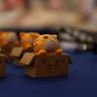
About Us
Member: TRUONG NHAT MINH QUANG
ID: ITITIU19194 (70% / 3)

Slide 5
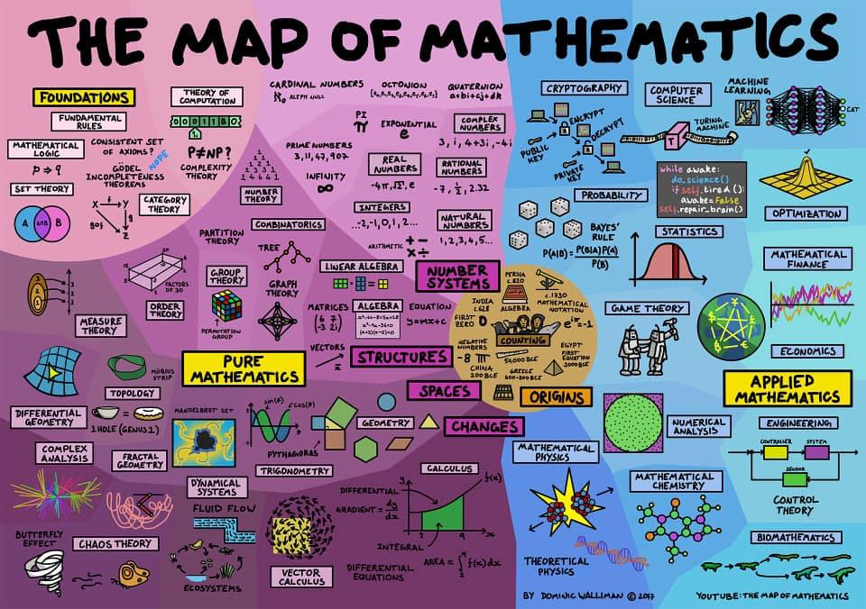
About Us
Member: TRAN MINH QUANG
ID: ITITIU19192 (70% / 3)

Slide 6

CONTENT

Slide 7
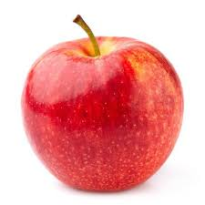
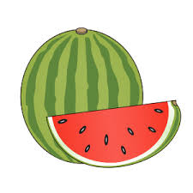
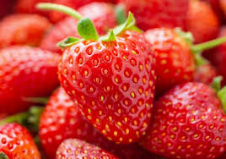
SFML Library
Food
https://www.sfml-dev.org/index.php
Multi-media, multi-platform, and multi-language.
Tutorial: included in GitHub with the name: Snake-Game-at-IU (public) – Full instruction to install the game
Three types of Fruit with random generator:
Apple: 2 points
Melon: 5 points
Strawberry: 10 points

Slide 8


Large image
ADDITIONAL FEATURES

Slide 9

Music
Game Status
Six (06) suitable music included
Can choose to pause or replay that music again without causing troubles
Restart function: Reset the game and randomize music
Immediate troubles from players. How to solve?
Pause, Replay, Restart, Mode Changing, and Exit button

Slide 10

Score Database
Programmers wants players to achieve some extent of satisfaction through score comparison.
No score is stored because player will continue playing over and over which decrease the working efficiency and attention, causing insomnia and headache if scores are stored

Slide 11

Game Mode (Part 01)
Four (04) different Game Mode: SingleEasy, SingleHard, DoubleEasy, DoubleHard (changeable).
Differentiating by “Delay” variable, Game Rules, and Obstacles

Slide 12
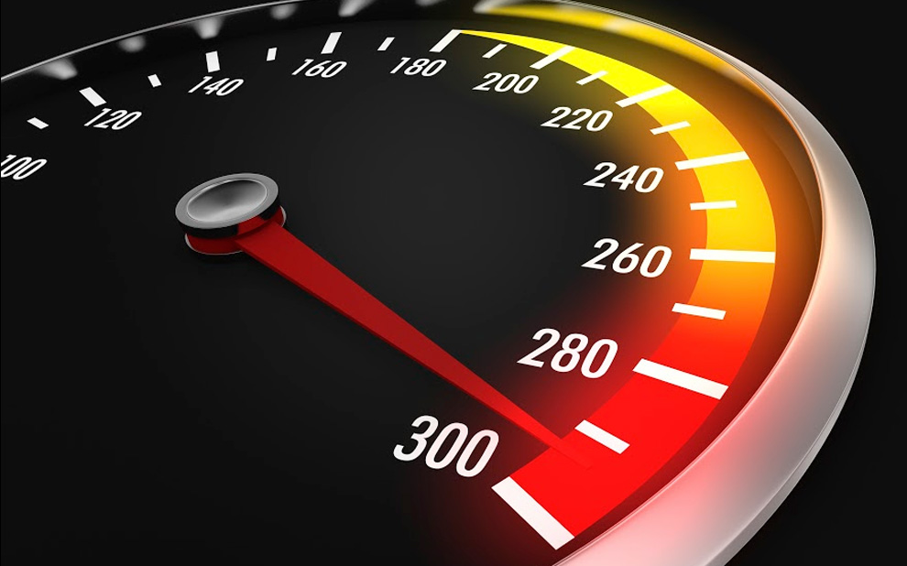
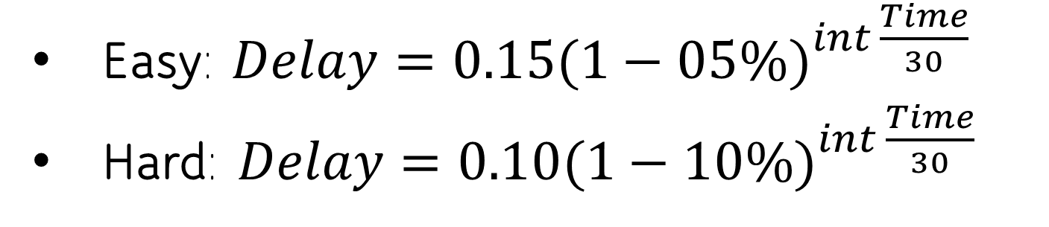
Game Mode (Part 02) – Delay variable
Delay variable is the most important variables in determining the speed of snake.
=> Most will fail after 15 minutes at Easy Mode and 7.5 - 10 minutes at Hard Mode (Human Reaction ranging from 0.1 s <-> 0.3 s
Easy: $Delay={0.15(1−05\%)}^{int \frac{Time}{30}}$
Hard: $Delay={0.10(1−10\%)}^{int \frac{Time}{30}}$

Slide 13
Time Passed (s) | Delay (s) in Easy Mode | Delay (s) in Hard Mode
0 | 0.15 | 0.1
60 | 0.1353 | 0.081
240 | 0.0995 | 0.0478
300 | 0.0898 | 0.0348
450 | 0.0694 | 0.0205
600 | 0.0537 | 0.0121
900 | 0.0323 | 4.239 x 10⁻³
1200 | 0.0193 | 1.478 x 10⁻³
1800 | 6.91 x 10⁻³ | 1.797 x 10⁻⁴
2400 | 2.477 x 10⁻³ | 2.185 x 10⁻⁵
3600 | 3.184 x 10⁻⁴ | 3.229 x 10⁻⁷

Slide 14

Game Mode (Part 03) – Game Rules
EASY MODE
Snake can pass wall, bite himself or other Snake
Low Speed Initial, less Obstacles (still random)
HARD MODE
Snake cannot pass wall, bite himself or other Snake
High Speed Initial, more Obstacles (still random)

Slide 15

Game Mode (Part 04) – Obstacles
EASY MODE
Durations: 20 seconds
After 35 seconds passed:
ObstacleNumber += 5;
HARD MODE
Durations: 30 seconds
After 45 seconds passed:
ObstacleNumber += 15;

Slide 16

Large image
CONCLUSION
WORTH-PLAYING GAMES

Slide 17
CITATIONS
01. https://www.sfml-dev.org/index.php

Slide 18





THANK YOU
Pham Hoang Minh
ITITIU19031
ITITIU19031@student.hcmiu.edu.vn
Group 01

